Slide 1

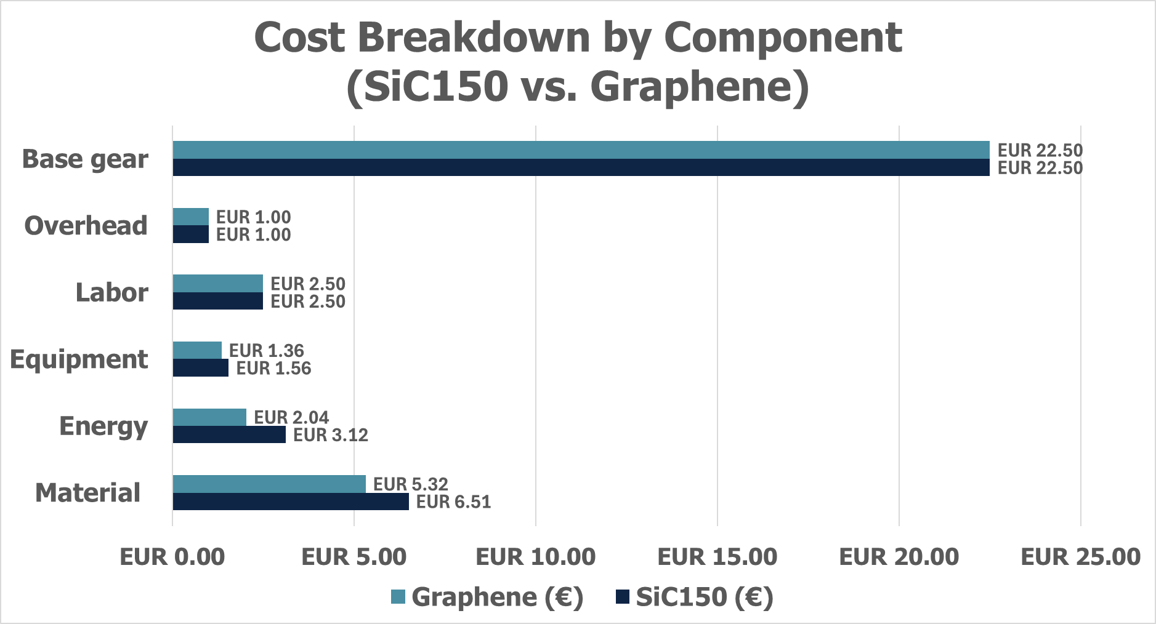
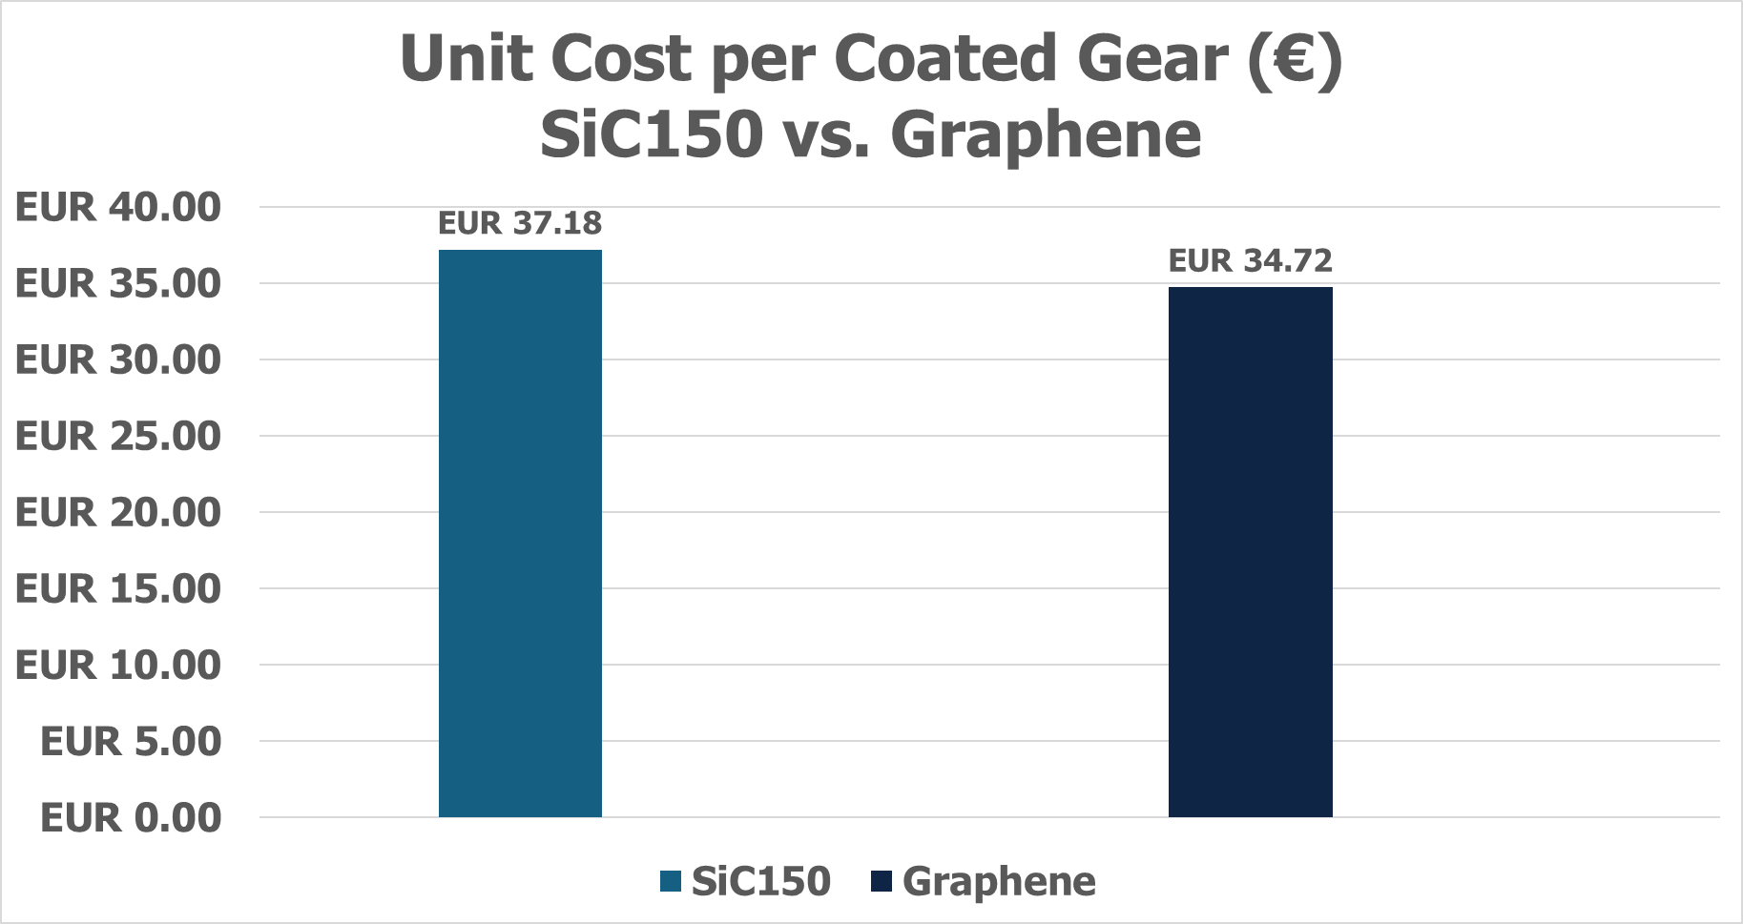
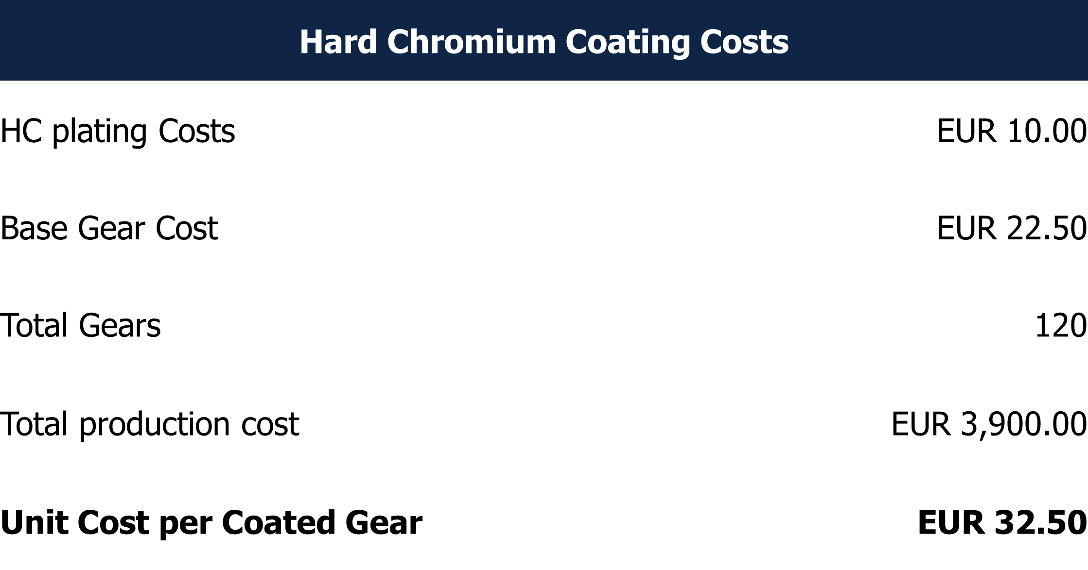
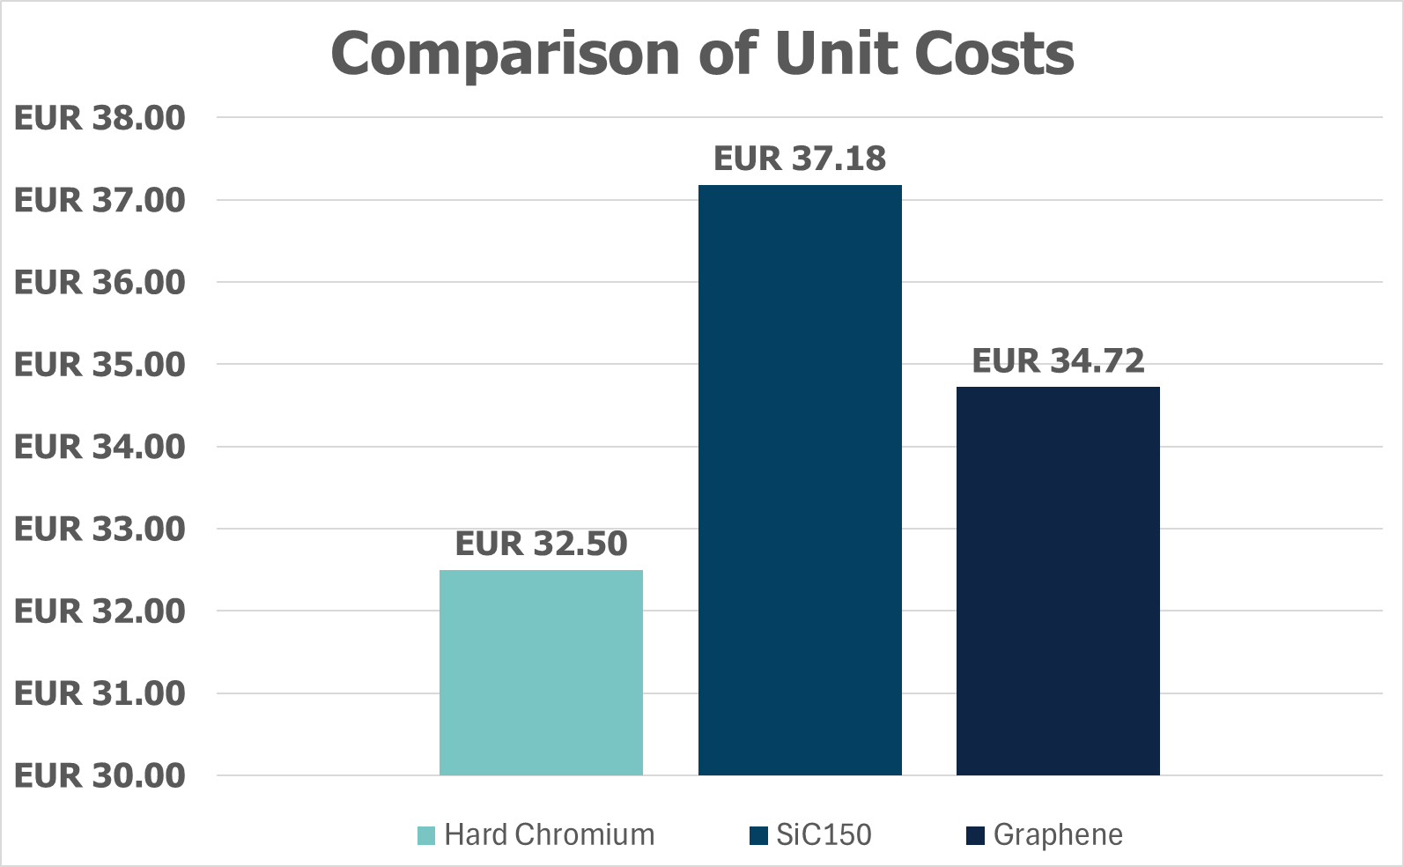


Financial Assessment of Advanced Gear Coatings:
A Comparative Cost Analysis of SiC150, Graphene, and Hard Chromium
Myrto Pelopida, Georgios Maris, Sotiria Tzampazidou, Dr. Ioanna Deligkiozi
Background
Methodology
Hard Chromium (HC) plating is widely used for gear protection due to its durability and cost-effectiveness. However, increasing environmental regulations and occupational health concerns are driving the need for safer and more sustainable alternatives.
This poster evaluates whether two advanced electroplated alternatives-SiC150 and Graphene coatings- can be suitable alternatives to HC coatings.
The overall objective is to evaluate the economic feasibility of SiC150 and Graphene coatings compared to conventional HC plating.
Each coating route was split into four process stages and costed:
Electrolyte preparation
Sample pre-treatment
Electroplating
Post-treatment
Key assumptions:
Batch size: 120 gears (60 SiC150 and 60 Graphene).
Gear surface: 0.022 m²
Average base gear cost: EUR 22.50 per piece.
Cost Calculations SiC150 vs. Graphene
Cost Calculations HC
HC vs. SiC150 vs. Graphene
Conclusions
While Hard Chromium remains the lowest-cost option at EUR 32.50 per coated gears, the advanced coatings offer additional benefits that are not captured by unit cost alone. SiC150 coatings amount to EUR 37.18 and Graphene coatings to EUR 34.72 per coated gear.
Although the new coatings are more expensive, they provide enhanced performance, including improved wear resistance, longer service life, and reduced environmental impact compared to Hard Chromium.
The Graphene coating offers a marginal cost advantage over SiC150, highlighting its potential as a cost-efficient alternative among advanced protective coatings.
This comparison supports decision-making for technology adoption, balancing both economic and functional performance considerations.
Acknowledgment: Funded by the European Union under Grant Agreement Number 101058450. Views and opinions expressed are, however, those of the authors only and do not necessarily reflect those of the European. Neither the European Union nor the granting authority can be held responsible for them.
Notes:
#0f2546
#034061
#498ea2
#79c5c4
#e7e6e5

